Slide 1



EasyFly
Presented by Group 01

Slide 2


List of Contents
Introduction
Member of Group
Project Overview
Actual requirements
Requirements of the project
Deployment diagram
Conclusion

Slide 3

Introduction
FlyEasy is not just another flight booking website; it's your ultimate travel companion. Our platform is built with a mission to provide you with a hassle-free and user-friendly interface for booking flights. Whether you're jetting off for business or leisure, FlyEasy ensures that every step of your journey, from selecting the perfect flight to making secure payments, is as smooth as the clouds you'll be soaring through.

Slide 4






Member of Group
Bùi Tuấn Khải
Lê Thị Trang
Trần Bảo Huyền Trâm
Ngô Thịnh Phát

Slide 5

Project Overview
The FlyEasy Project is an ambitious endeavor aimed at revolutionizing the way individuals book their flights. In a world where travel is an integral part of modern life, FlyEasy offers a user-centric flight booking platform that seamlessly combines convenience, choice, and reliability. This project seeks to create a transformative online space where travelers can effortlessly plan their journeys, from selecting flights to making secure payments.

Slide 6
Actual requirements
User Management:
Account creation with unique usernames and passwords.
Secure user authentication and session management.
Flight Booking:
Search functionality based on departure, destination, dates, and preferences.
Display of flight details including airlines, prices, and times.
Payment and Confirmation:
Support for various payment methods: credit/debit cards, digital wallets, online banking.
Confirmation emails with comprehensive booking details.

Slide 7
4.User Profiles and History:
User profiles for storing personal information and booking history.
Accessible view of past and upcoming bookings.
5. Customer Support:
24/7 customer support through email, phone.
6. User Interface and Experience:
Intuitive and responsive interface catering to diverse user levels.
Fast website loading (within 3 seconds).
Swift search query and result generation (within 2 seconds).

Slide 8




Requirements of the project
Functional
Users must be able to create accounts with unique usernames and passwords.
Secure user login functionality with session management.
Users can view their booking history
Search feature enabling users to find flights based on departure, destination, dates, and preferences.
User Registration and Authentication
Flight Search and Booking
Booking history &Passenger Information

Slide 9
Non-Functional
Intuitive user interface catering to different tech levels.
Responsive design across devices.
Fast website loading (within 3 seconds).
Swift search query and result generation (within 2 seconds).
Mechanisms to manage unexpected downtime and prevent data loss.
Usability
Performance
Reliability

Slide 10
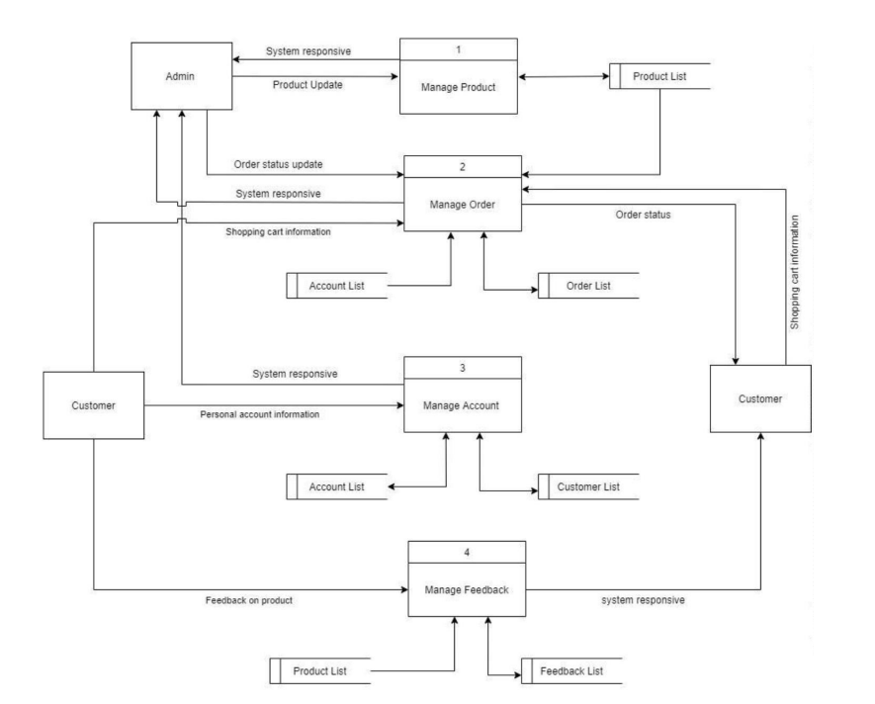
Deployment diagram

Slide 11

Conclusion
In conclusion, the FlyEasy Project embarks on a mission to redefine the way individuals book their flights. With a user-centered approach and a commitment to seamless functionality, FlyEasy aims to streamline every aspect of the flight booking process, from search to confirmation. By uniting cutting-edge technology with intuitive design, the platform strives to provide travelers with an unparalleled booking experience.

